Slide 1


HR Analytics Job Changes in Data Scientists
Terry Lay
AIGC5000 Humber College
Notes:
Why did we choose this dataset:
Many of us will graduate from this program to become data scientists or big data analysts.
We felt it would be interesting to see from an HR perspective the type of candidates who are interested in these types of positions
We also wanted to get an understanding of the types of factors a real HR department might look at when analyzing the job market

Slide 2
Problem Statement
Company wants to hire data scientists among people who successfully pass the courses they conduct
Which candidates are seeking new employment opportunities?
Objective: Reduce cost and time spent on the recruitment process
Binary classification problem: 1 – candidate is looking for a job change or 0 – candidate is not looking for a job change
Notes:
A company wants to hire data scientists among people who successfully pass the courses they conduct.
There is a large number of people who sign up for their training and they want to know which of these candidates want to work for the company or are seeking new employment opportunities.
Their objective is to reduce the cost and time spent on the recruitment process by predicting whether the candidate is looking for a job change.
This is a binary classification problem, and we are interested in classifying: 1 – if the candidate is looking for a job change or 0 – if the candidate is not looking for a job change

Slide 3

HR Analysis
HR is interested in understanding factors leading a person to switch jobs
What are the prospects of candidates with different credentials, experience and demographics?
How can we compare and interpret these factors to understand employee decisions?
Notes:
This analysis will focus on several factors that could influence a person to seek new employment opportunities in data science
What can we learn from our dataset?
Prospects of candidates with different credentials, experience and demographics
How to compare and interpret different factors that affect an employee’s decision to leave their current position
HR department is also interested in understanding: of the candidates interested in a job change, how can they invest into the courses they offer to attract similar enrollees in the future?

Slide 4
Dataset Discussion
19,158 Observations
Categorical features we will examine:
The city where the candidate is from
Does the person have relevant experience (Yes or No)
Is the person not enrolled in any courses? (Part time, Full time, or No)
The level of education the person has attained
The education discipline of the candidate (I.e STEM, Humanities, Other)
The total experience in years the candidate possesses (from ‘<1’ to ‘> 20’)
The difference in years between their previous job and current job (from ‘never’ to ‘>20’
Numerical features we will examine:
The development index of the city
The number of training hours they completed from the courses
Notes:
Our model and observations will depend on the following variables:
city: The city code of where the candidate is from
city_development_index: Development index of the city (scaled)
relevant_experience: If the person has or does not have relevant experience
enrolled_university: Is the person studying part time, full time or not enrolled in any courses
education_level: The level of education the person has achieved
major_discipline: Education discipline of the candidate
experience: The candidate’s total experience in years from ‘<1’ to ‘>20’
last_new_job: Difference in years between their previous job and current job from ‘never’ to ‘>4’
training_hours: The number of training hours they completed

Slide 5
Preparing the Data
Features we did not include:
Enrollee ID: The training ID of the enrollee has no predictive power in determining the class
Gender: This was dropped to avoid potential gender bias in our algorithm and analysis
Company size and company type of the candidate’s current job contained over 30% missing values that could not be appropriately filled
Handling missing values: 18,643 of 19,158 remaining observations
Missing values in university enrollment status filled with ‘no enrollment’
Anyone without a university level education has no major discipline
Anyone missing data regarding previous work experiences had never had a job before (‘N/A’ or ‘Never’ was filled accordingly)
Observations with missing values in level of education were removed
Notes:
We did not include all the features in our analysis.
The original dataset also included variables such as enrollee_id, gender, company_size, and company_type.
We dropped enrollee_id from our dataset because it does not provide any predictive power in classifying the target variable.
Gender was not considered in our analysis because we did not want to introduce potential gender bias since there is an imbalance between male and female candidates.
Finally, company_size and company_type were included in the dataset but had over 30% missing values so we disregarded them from our analysis.
After preprocessing and handling missing values, we were left with 18,643 observations from 19,158.
Missing values in university enrollment status filled with ‘no enrollment’
Anyone without a university level education has no major discipline
Anyone missing data regarding previous work experiences had never had a job before (‘N/A’ or ‘Never’ was filled accordingly)
Observations with missing values in level of education were removed

Slide 6
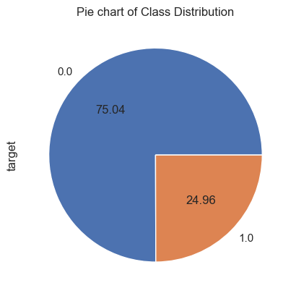
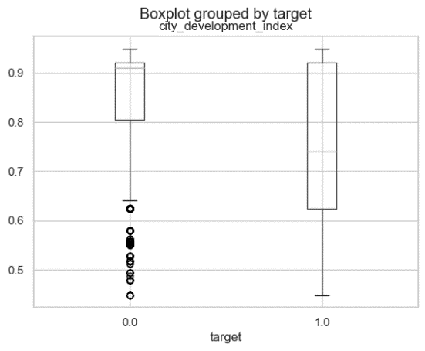
Data Analysis and Visualizations
Class distribution
Imbalanced
75% of candidates are not looking for a job change
City development index:
Candidates not interested in a position at the company are from cities with higher development index
More opportunities may be available for those who come from highly developed cities
Notes:
To analyze the dataset, it is important to understand the distribution of our target variable.
We can see that approximately 75% of the candidates are not looking for a job change.
We will need to be mindful when building our model of this imbalance, because we do not want a model that is biased towards the majority class and deny potential candidates an opportunity at the company
-----------
The boxplot on the right shows the distribution of city_development_index grouped by the target variable.
Among those who are not interested in a new job, the distribution is heavily skewed and most of them seem to be from cities that are more developed.
This may be due to more available opportunities other than the ones offered at the company of interest in comparison to those from lesser developed cities

Slide 7
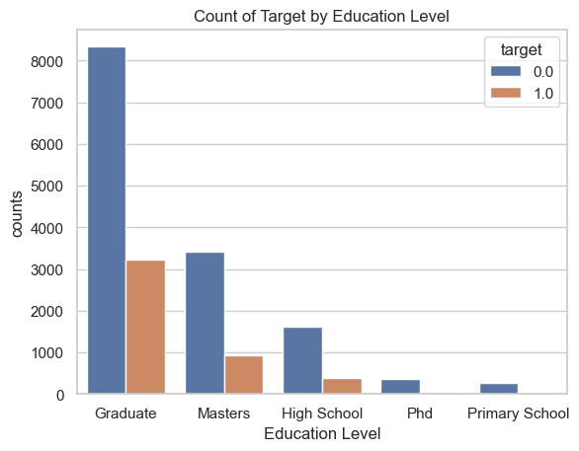
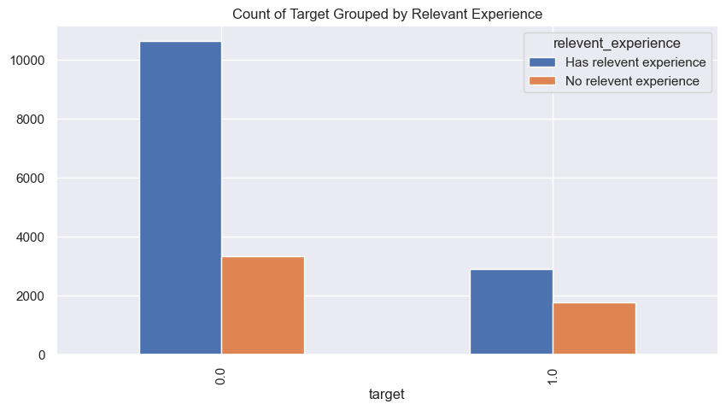
Data Analysis and Visualizations
Based on education level:
Proportion of candidates with high school, graduate, or masters level education are similar
Almost no candidates with PhD or primary education are interested in a job position
Based on relevant experience:
Greater proportion of candidates interested in the job do not have relevant experience
May indicate that the opportunities available at the company are primarily entry or mid level
Notes:
The proportion of candidates seeking new job opportunities is similar among people with high school, graduate, and masters level education.
There are almost no candidates with a PhD or primary school level education who are interested in the job.
This may be because those who only have primary school education feel underqualified for the opportunity, whereas those with a PhD feel they are overqualified.
------------------------------
Finally, the figure on the right displays the distribution of the target variable grouped by whether or not a candidate has relevant experience.
It appears that there is a noticeably greater proportion of people who are interested in the job that do not have relevant experience compared to those who are not interested.
This may be an indication that the opportunities available for this company are targeted to those at an entry or associate level.

Slide 8
Proposed Analytical and Predictive Model
Majority of features are categorical
Education level, experience, last new job are ordinal
City development index and number of training hours are continuous variables
Random Forest Classifier vs Logistic Regression
Hyperparameter tuning: Random Search Cross Validation
Imbalanced class means prediction accuracy is misleading when evaluating model performance
Class weights to penalize/discourage bias in model
Precision, recall, F1 score
AUC (Area Under Curve)
ROC (Receiver Operating Characteristic Curve) – True positive rate to false positive rate
Notes:
The majority of our features are categorical.
Only city_development_index and training_hours are continuous variables.
From our categorical features, education_level, experience, and last_new_job are ordinal.
For this binary classification problem, we will train a Random Forest Classifier and Logistic Regression model. Random Search Cross Validation will be used for hyperparameter tuning.
Since the target variable is imbalanced, prediction accuracy is a misleading metric to evaluate model performances.
Our results will be compared using precision, recall, F1 score and AUC/ROC.
We will use weights to discourage our model from being biased towards the majority class.

Slide 9
Feature Importance According to Random Forest
feature | importance
city_development_index | 0.244905
training_hours | 0.241105
experience | 0.149932
enrolled_university | 0.086031
city | 0.083493
last_new_job | 0.069297
relevent_experience | 0.049779
education_level | 0.042413
major_discipline | 0.033044
Notes:
City development index and number of training hours a candidate completed is the best indicator of whether they are interested in an opportunity at the company
We can infer that people who put in more time to complete their courses are interested in a job, whereas those who are there for their own self-learning are not as dedicated
Major discipline is least important. We can infer that everyone enrolled in the course is interested in data science and already has the required background knowledge to be able to do the training

Slide 10
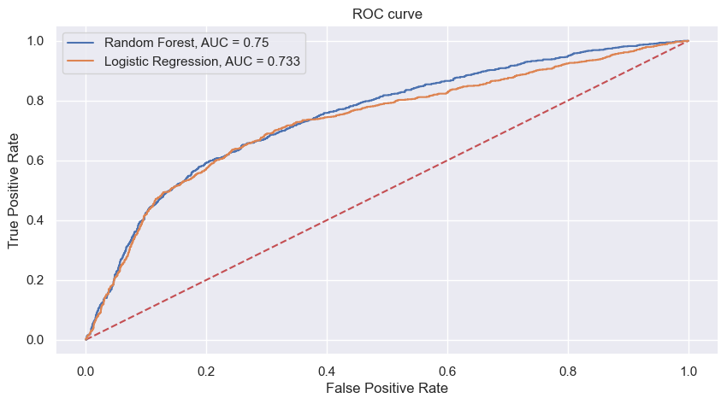
Results
Metrics (Weighted Average)
Random Forest | Logistic Regression
Accuracy: 0.75 | Accuracy: 0.72
Precision: 0.75 | Precision: 0.71
Recall: 0.75 | Recall: 0.72
F1 Score: 0.75 | F1 Score: 0.71
Best model: Random Forest
ROC curve shows similar model performances, Random forest had slightly better metrics
10/11
Notes:
The Random Forest Classifier was better across all metrics, but the ROC curve shows both models performed similarly.

Slide 11
Discussion
Weights were added to avoid too many false negatives
HOWEVER: maximizing recall is not the primary objective
The company wants to allocate resources based on the number of true positives (precision)
How can their courses be targeted towards those who are interested in new opportunities?
Eliminating many candidates at this step is not detrimental to their objective
There are costs associated with screening more candidates
Next steps:
Predict probabilities – candidates with higher probability of being interested should be prioritized
In a real-life situation, a threshold can be set to consider a limited number of candidates only
If used for screening candidates, more exploratory analysis would be useful for HR
Are their minimum educational requirements they are seeking?
How do candidates of different disciplines compare with each other?
11/11
Notes:
When fitting our model, we included weights to avoid too many false negatives, but our primary objective is not to maximize recall.
We need to keep in mind that the company does not want to waste resources on people who will not move forward with the job process, so eliminating candidates at this step of their HR analysis is not detrimental to their objective.
The training results from those that are interested in employment opportunities would be further analyzed to understand how the company can allocate resources to cater their courses to attract those specific groups of people
Next steps:
We could predict probabilities - Candidates with a higher probability of being interested should be prioritized overall.
In real life situations, a threshold could be discussed with hiring team to ensure the model only accepts a limited number of candidates
For HR screening purposes, more exploratory analysis would be useful
For example, if they are focused on specific groups of people who possess certain credentials, they would be interested in studying those candidates
They would also be interested in knowing how candidates of different educational backgrounds or disciplines compare with each other

